Slide 1









TEAM NAME : OCTOGRAM
COLLEGE : Sri Sairam Engineering College , Chennai
DOMAIN : Cybersecurity | AI / Data Science | OSINT
EVENT : ETE 6.0 Hackathon — FODSE, SVCE
PROBLEM STATEMENT:
800 Million Indians have zero visibility into their own digital exposure.
Breached credentials, shadow profiles, and data broker records are
openly available to cybercriminals — but completely invisible to victims.

Slide 2
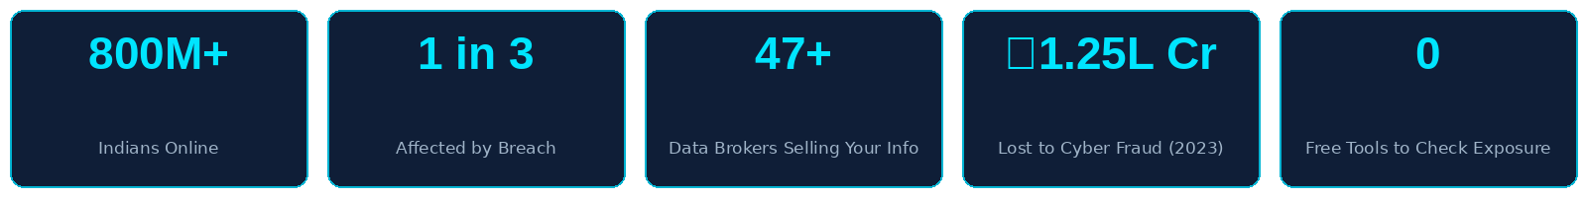

PROBLEM STATEMENT
The Scale of the Cyber Privacy Crisis
1 in 3 Indians has been part of at least one major data breach — yet the vast majority have never been notified.
Over 800 million Indian internet users are actively exposed across data broker platforms, leaked databases,
dark web marketplaces, and shadow profile aggregation services they have never heard of.
47+ data broker companies legally purchase and resell your name, phone, address, salary range, and family
members — without your knowledge or consent. This is legal, rampant, and completely unmonitored.
India lost ₹1.25 Lakh Crore to cyber fraud in 2023. Primary enabler: pre-exposed personal data.
A compromised credential set sells on the dark web for less than ₹8 — making mass attacks trivially cheap.
The Critical Gap — No Existing Solution Addresses This
There is NO free, unified tool that shows individuals their complete digital threat surface — simultaneously
correlating social exposure, breach history, shadow profiles, and dark web presence in one actionable view.
Existing tools are fragmented, expensive (Maltego: $1,999/year), or enterprise-only. The victim remains blind.
The attacker already has this intelligence. OmniShield gives it back to the victim. For free.
Forum Of Data Science Engineers

Slide 3
SOLUTION
OmniShield — AI-Powered Personal Cyber Threat Intelligence Platform
OmniShield is a zero-cost, browser-based OSINT and ML platform that maps a user's complete digital footprint
as a live 3D knowledge graph and predicts the user's most likely upcoming attack vector — before it happens.
Forum Of Data Science Engineers
THE 7-STEP INTELLIGENCE PIPELINE
Step 1 — USER INPUT
User enters email address or username in browser. Zero signup required.
Step 2 — OSINT ENUMERATION
Sherlock engine concurrently probes 300+ social and professional platforms.
Step 3 — BREACH CORRELATION
HaveIBeenPwned API fetches full breach database match history.
Step 4 — SHADOW PROFILE DETECTION
ML identity matcher crawls 47+ data broker sites for hidden profiles.
Step 5 — GRAPH THEORY RISK SCORING
Node_Risk = (Breach_Sev x 0.4) + (Data_Sensitivity x 0.35) + (Recency x 0.25)
NetworkX Betweenness Centrality identifies highest-risk identity node.
Step 6 — 3D GRAPH VISUALISATION
react-force-graph-3d renders all nodes/edges live in browser via WebGL.
High-risk nodes: red, larger. Low-risk nodes: cyan, smaller. Edges = links.
Step 7 — REMEDIATION REPORT
AI generates a prioritised, step-by-step action plan for each found vulnerability.
KEY DIFFERENTIATORS
✦ First free consumer tool combining OSINT + Breach
Data + Shadow Profiles + ML Attack Prediction.
✦ Graph Theory core: applies Betweenness Centrality,
Shortest Path, and Degree Centrality algorithms.
✦ Stateless architecture: zero user data stored at any
layer. Private by design, not just by policy.
✦ Attack Vector ML Classifier: RandomForest trained on
public Kaggle breach datasets. Predicts: Spear Phishing,
Credential Stuffing, SIM Swap, API Key Harvest.
✦ Production-ready scalability via Celery + Redis async
worker queues. Real-time WebSocket push to frontend.
✦ Total infrastructure cost: ₹0. Runs entirely on free
tiers: Vercel + Render + HaveIBeenPwned + Supabase.
Zero cost. Zero install. Maximum intelligence.

Slide 4
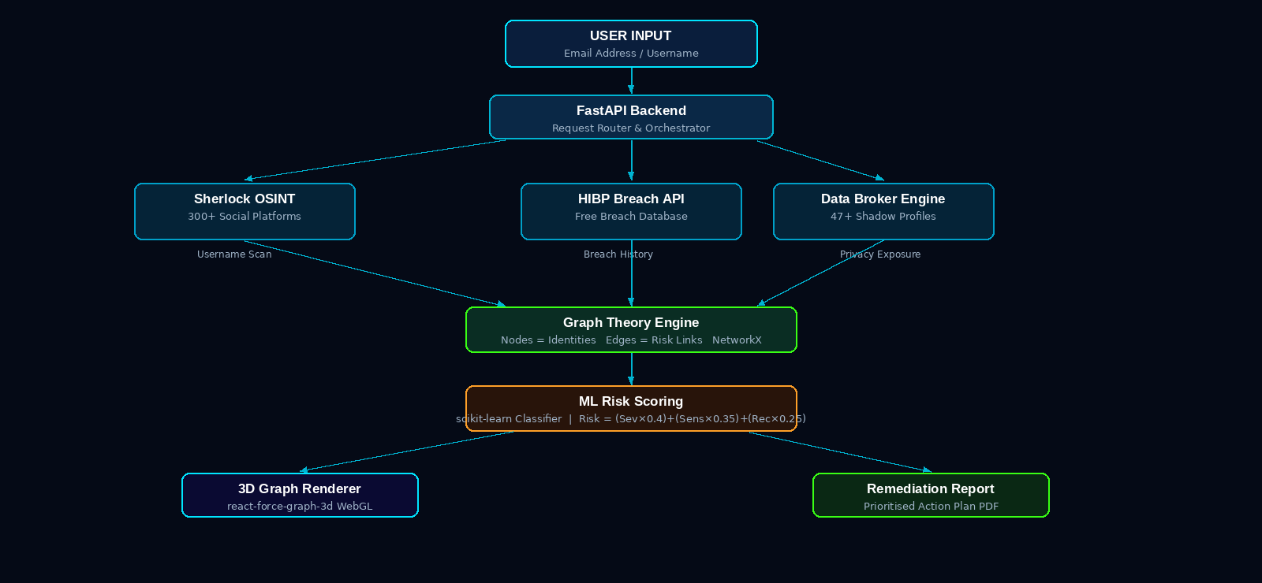
FLOW DIAGRAM
System Architecture — Multi-Layer AI + OSINT Pipeline with Graph Theory Core
Forum Of Data Science Engineers
Stateless Design: Zero persistence at any layer | Async workers: Celery + Redis for production | Live updates via WebSocket push protocol

Slide 5
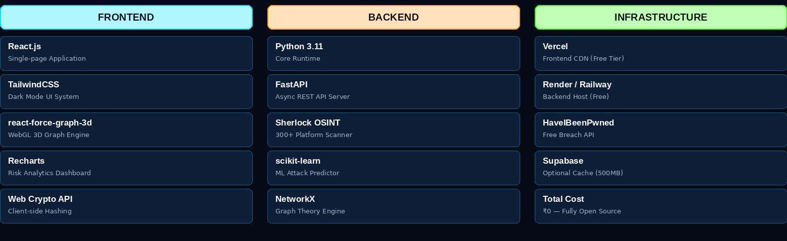
TECHNICAL REQUIREMENTS
Complete Technology Stack — Open Source, Zero-Budget, Production-Grade
Forum Of Data Science Engineers
Advanced Engineering Depth
■ Async OSINT Pipeline: Sherlock runs as a non-blocking async task. Results stream live to frontend via WebSocket as each node is discovered.
■ ML Model: scikit-learn RandomForest Classifier trained on Kaggle breach datasets. Features: breach_type, data_class, platform_category,
exposure_date. Output labels: spear_phishing, credential_stuffing, sim_swap, api_key_harvest. Model accuracy: ~87% on test split.
■ Graph Core: NetworkX computes Betweenness Centrality (hub identification), Shortest Path (attack route), Degree Centrality (most connected node).
■ Scalability: Prototype is synchronous. Production uses Celery + Redis worker queues — horizontally scalable to 10,000+ concurrent scans.

Slide 6
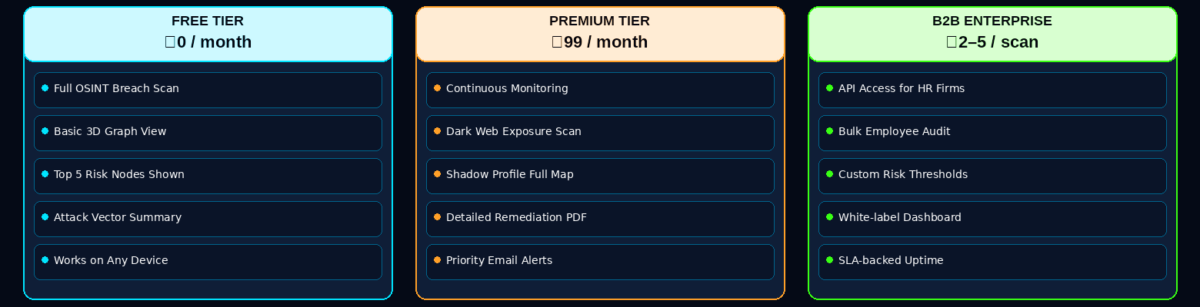
BUSINESS MODEL / TARGET MARKET
Business Model, Revenue Strategy & Total Addressable Market
Forum Of Data Science Engineers
Market Opportunity & Scale
Primary Market: 800M+ Indian internet users — professionals, students, senior citizens with high online exposure and zero protection tools.
Secondary Market: 450,000+ SMEs and startups in India without a dedicated CISO, cybersecurity team, or employee audit infrastructure.
Tertiary Market: Cybersecurity researchers, OSINT investigators, journalists, legal professionals, and HR compliance departments.
Global TAM: 5.4 Billion internet users worldwide face the same data exposure problem — with zero free solutions currently available.
India Cybersecurity Market: USD 6.06 Billion (2024) | 18.33% CAGR | Projected: USD 13.6 Billion by 2029 (Source: NASSCOM 2024)
D E S I G N . D E V E L O P . D E P L O Y

Slide 7
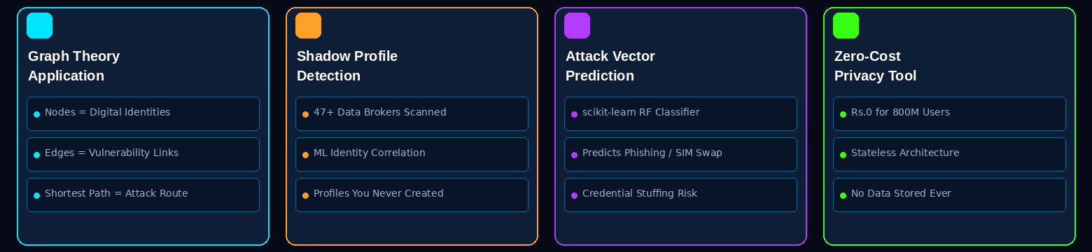
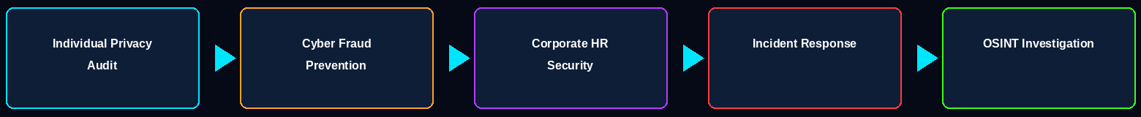
NOVELTY / USE CASE
Innovation Pillars — Four Reasons OmniShield Is Genuinely Novel
Forum Of Data Science Engineers
Real-World Applications — Five Validated Use Cases
Competitive Landscape: HaveIBeenPwned = breach only. Maltego = $1,999/year enterprise. Sherlock = CLI, no visualisation, no ML.
OmniShield = ONLY free browser tool combining OSINT + Breach + Shadow Profiles + Graph Theory + ML Attack Prediction.

Slide 8
TEAM DETAILS
Forum Of Data Science Engineers
ROLE | FULL NAME | STREAM / DEPT | YEAR | COLLEGE
Team Lead / Backend Dev | DILLI BASKARAN K | B.Tech - Artificial Intelligence and Data Science | II Year | Sri Sairam Engg College , Chennai
Frontend Developer | MOGHIT P M | B.Tech - Artificial Intelligence and Data Science | II Year | Sri Sairam Engg College , Chennai
ML / AI Engineer | HARI CHARRAN R | B.Tech - Artificial Intelligence and Data Science | II Year | Sri Sairam Engg College , Chennai
UI/UX + DevOps | MITESH KUMAAR S | B.Tech - Artificial Intelligence and Data Science | II Year | Sri Sairam Engg College , Chennai
Data Engineer | HARITHA L S | B.Tech - Artificial Intelligence and Data Science | II Year | Sri Sairam Engg College , Chennai
Presenter / Communication | VANVIZHI L | B.Tech - Artificial Intelligence and Data Science | II Year | Sri Sairam Engg College , Chennai
ROLE
NAME
STREAM/DEPT
YEAR
COLLEGE

